Slide 1

Second Presentation: BS Final year project
OPTICAL PROPERTIES OF GAIN INCORPORATING PHOTONIC RESONATORS
Ahmad Bilal
Supervisor
Dr. Ahmer Naweed

Slide 2
Introduction
(resonators)
An optical resonator is a device that naturally oscillates at some frequency called resonant frequency.
These resonators can be used to store light.
We will extend this research on gain incorporating resonators, which have a wide number of applications in photonic devices.

Slide 3
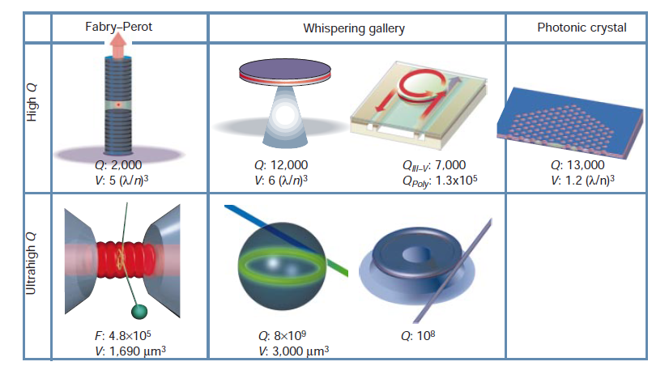
Types of Resonators
(optical microcavities)
K. Vahalla, “Optical microcavities,” Nature 2003

Slide 4
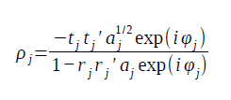

Fabry–Perot interferometer
L
Incident field
E_{i}
E_{t}
Transmitted field
Reflected field
E_{r}
t_{j} = transmission coefficient of mirror 1
t_{j}’ = transmission coefficient of mirror 2
r_{j} = reflection coefficient of mirror 1
r_{j}’ = reflection coefficient of mirror 1
Φ = phase
a = attenuation constant
r₁
t₁
r₂
t₂

Slide 5
Selected Methodology and formulation
I have studied symmetric and asymmetric Fabry-Perot resonator.
I have extended this study to ring-resonators as well, as they are believed to play an important role in future of communication system.
I inspected both reflection and transmission characteristics.

Slide 6
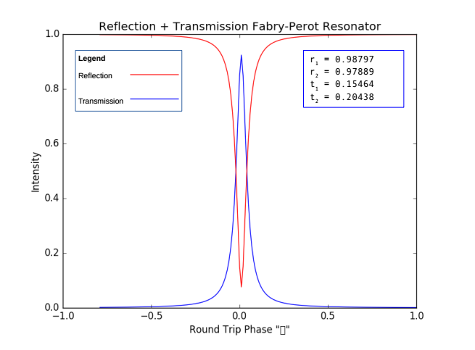
Results

Slide 7
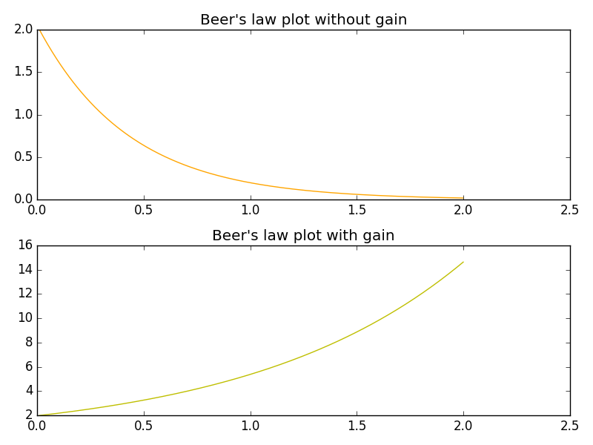


Beer’s Law
(with and without gain)
α = 1.001
Intensity
g = 1.001
Distance

Slide 8
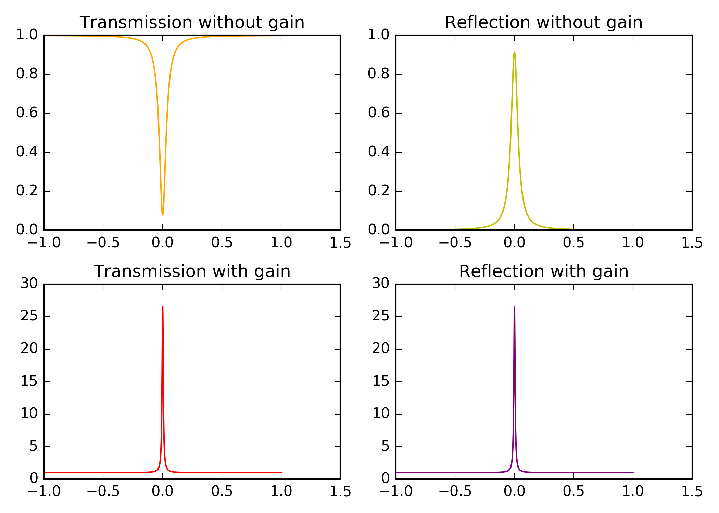
Ring-resonator plots
Intensity
phase

Slide 9
Strategy/Plan of work
Gather more information on background material.
Reproduce the previously done work.
Add methods of analysis .
Learning coding in Mathematica/Python.
Further modeling the optical properties of resonators.

Slide 10
Expected outcome
It is anticipated that resonant optical features of active resonators as well as the underlying physics will be distinct from passive resonators.
Resonators with gain may enable control over resonator-wave guide coupling regimes and photon storage time in resonators.

Slide 11
Next phase
Work on coupled resonator system and introduce gain medium in the resonator.
Solve for different parameters of the resonator.

